Slide 1
FCR Optimization
By
Vinoth

Slide 2
Agenda
FCR
Feature Extraction
Feature Analysis and Importance
Data irregularities
Model Building
Evaluation Techniques
Model Quality
Data Insights

Slide 3
What is FCR?
FCR stands for First Contact Resolution
First call which provides solution to the customer
Customer Satisfaction highly depends on FCR
FCR measures how effectively service desk conducts business

Slide 4
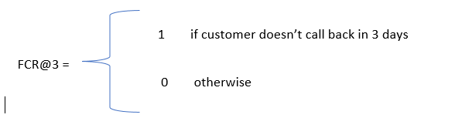
FCR Derivation
FCR is something that needs to be computed
Feature Extraction – Call Date Time, Call Interval, Rank

Slide 5
Feature Extraction
Data from June 2018 – December 2018 is considered
Call Date → Month & Day
Call Time → Hours, Minutes & Seconds
Queue start & end time → Queue Duration
Call start & end time → Call Duration

Slide 6
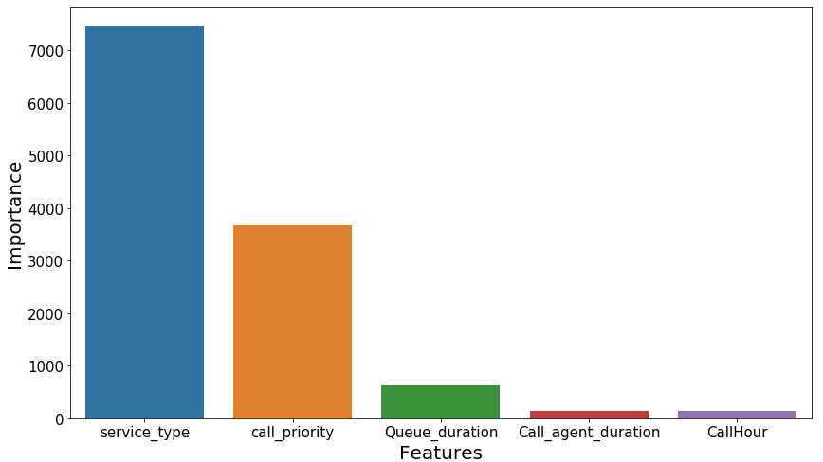
Feature Importance
Features may vary with their significance to predict target
Importance of the features to target variable are found statistically

Slide 7
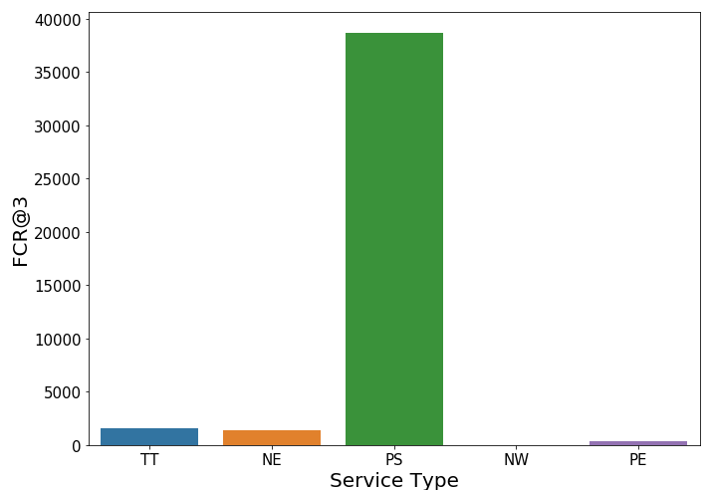
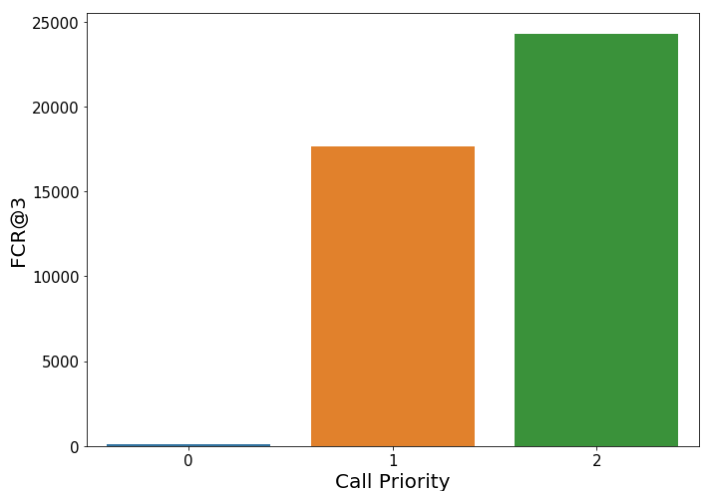
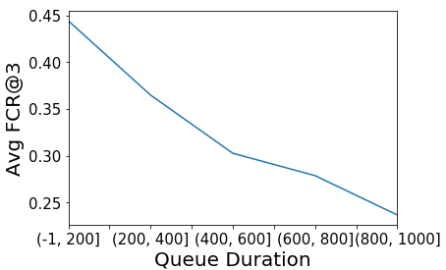
Why its Important?
Service Type
Call Priority
Queue Timing

Slide 8
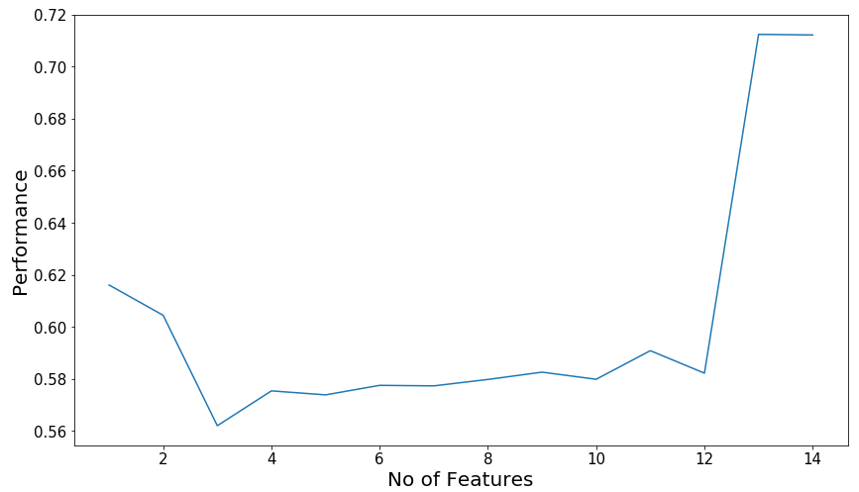
Feature Selection
Backward Elimination from least to most important features

Slide 9
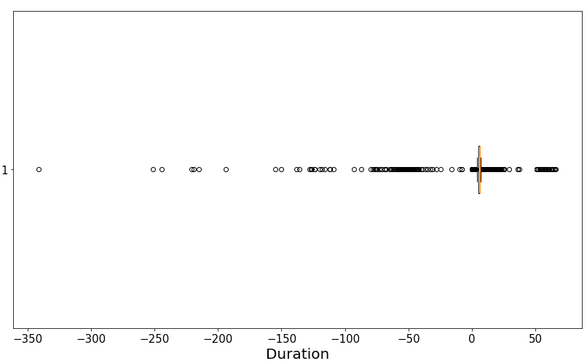
Data Irregularities
Negative values in duration
0.1% values are negative

Slide 10
Evaluation Metrics
Needed to select the best
Assess our model in terms of result
Provides Reliability to the model
Our Evaluation metrics – ROC AUC & F-Score

Slide 11
F-Score & ROC AUC
F-Score helps to evaluate both model performance and accuracy
Better measure for imbalanced data
ROC evaluates the misclassification of the model
ROC provides the better cut-off value to convert probability to decision
AUC helps to choose the best model for our requirement

Slide 12
Model Building Steps
Load the data
Pre-process the data – Data cleaning and Data conversion
Feature Analysis & Extraction
Categorical encoding
Exploratory Data Analysis
Model fitting & Hyper-parameter tuning
Pick the best
Evaluate with new data

Slide 13
Model Selection
Model | ROC AUC Metrics | F-Score
Logistic Regression | 61.06% | 50%
Lasso classification | 61.9% | 59%
Ridge Classification | 61.1% | 50%
Decision Tree | 73.1% | 69%
Random Forest | 71.7% | 678%
AdaBoost | 70.6% | 66%
Light Gradient Boost | 84.1% | 75%

Slide 14
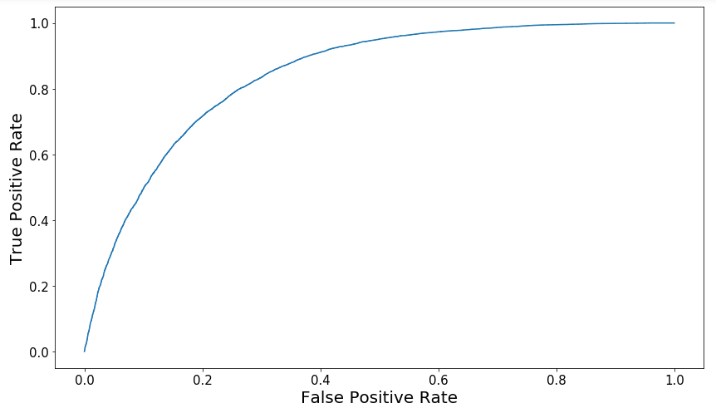
Model Metrics
ROC AUC – 84.1%
F-Score – 75%

Slide 15
Model Quality
Cross validation makes our model robust
Stratified technique helps our model to overcome sample bias
Parameter tuning helps our model to pick the right number for our data
Good ROC AUC value makes our model reliable

Slide 16
Data Insights

Slide 17
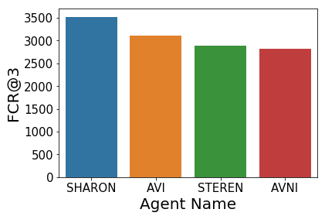
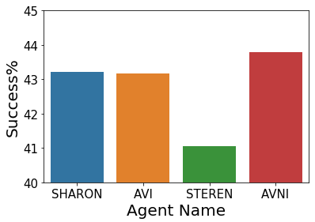
Who is the best?
Productivity
Success Rate

Slide 18
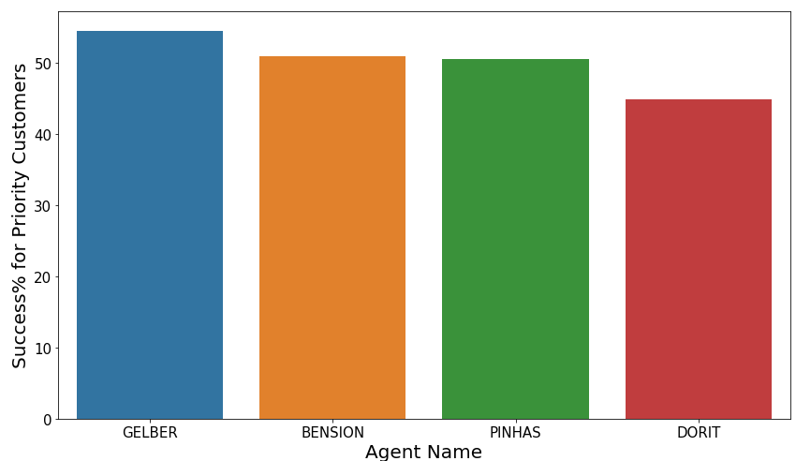
Customer Matters
Best Persons to deal with priority customers

Slide 19

Any queries?

Slide 20
Thank you

